Slide 1
Azure SQL Migration extension in Azure Data Studio
Assess and migrate SQL Server databases to Azure SQL
powered by Azure Database Migration Service (DMS)

Slide 2
Azure SQL Migration extension in Azure Data Studio
Assess and migrate SQL Server databases to Azure SQL
powered by Azure Database Migration Service (DMS)

Slide 3
Azure SQL Migration
Current landscape of tools and services
DMA
DMS
What’s new in Azure SQL Migration
Solutions for migration personas
Migration principles
Migrations from ADS
Architecture
Key component
Enhanced capabilities
How to get started
Demo

Slide 4
Current landscape

Slide 5
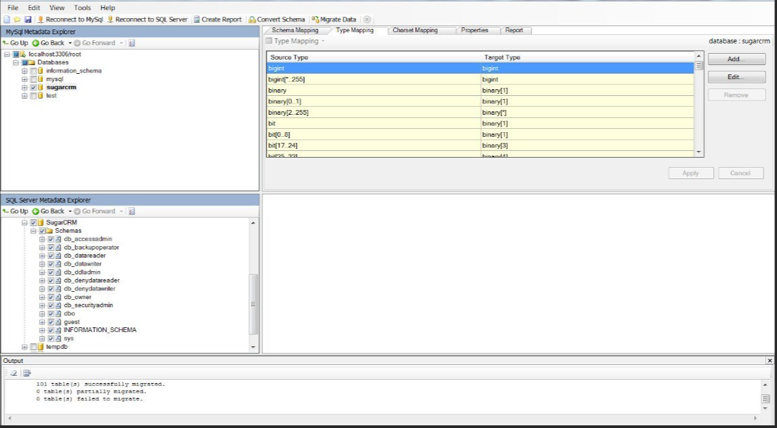
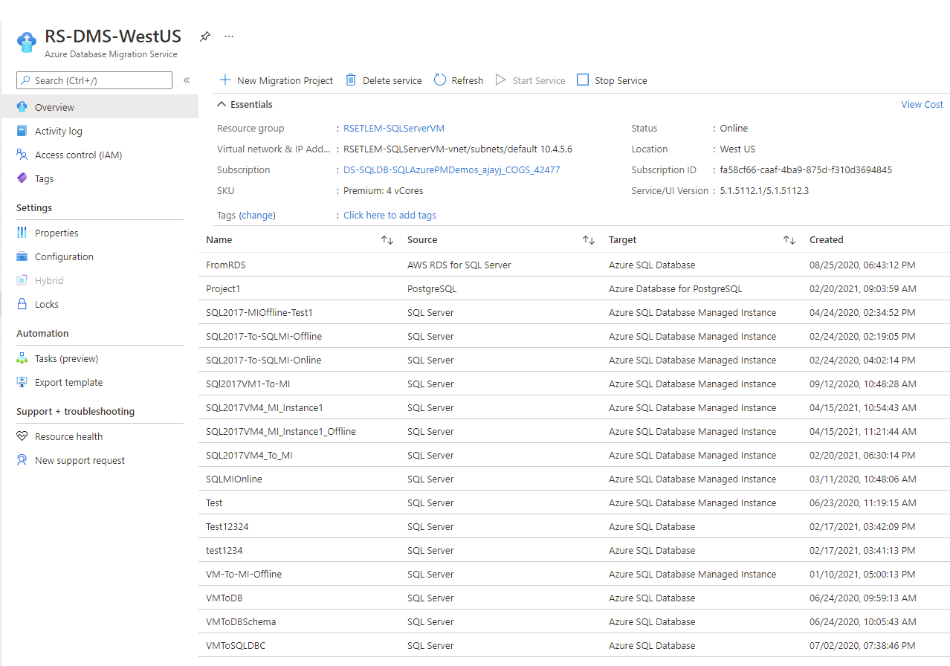
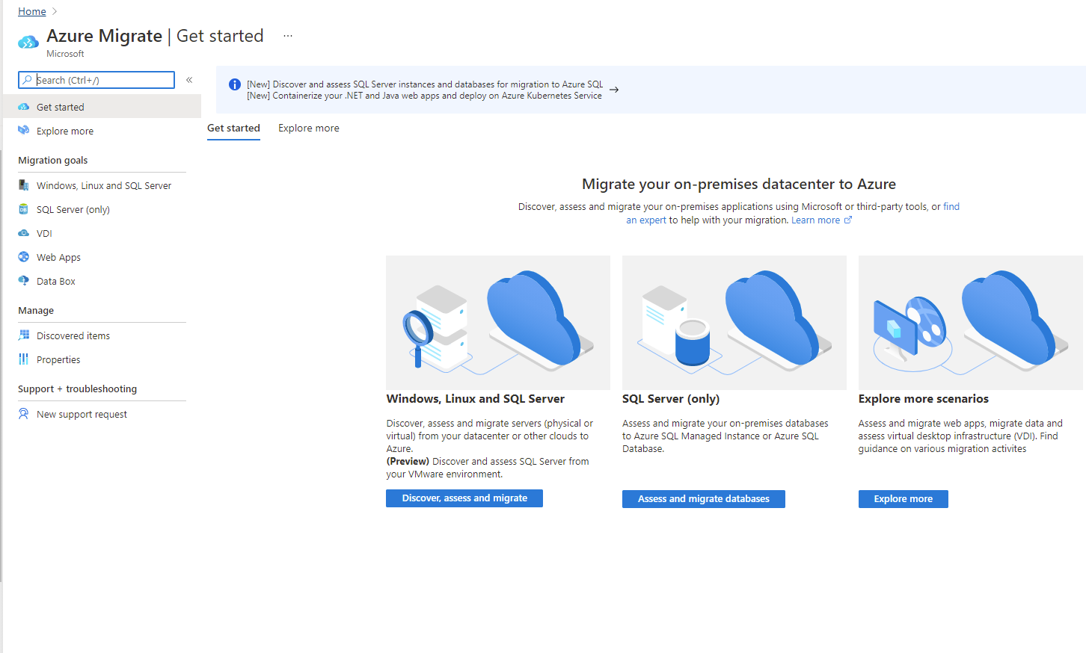
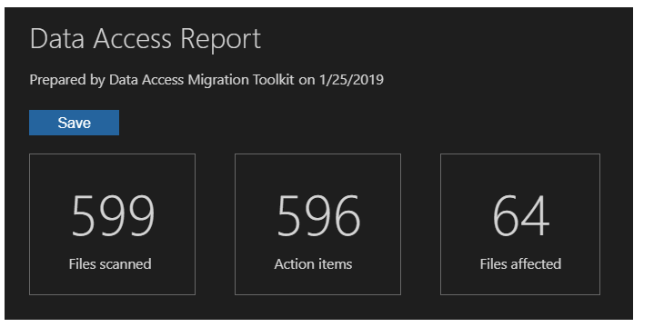
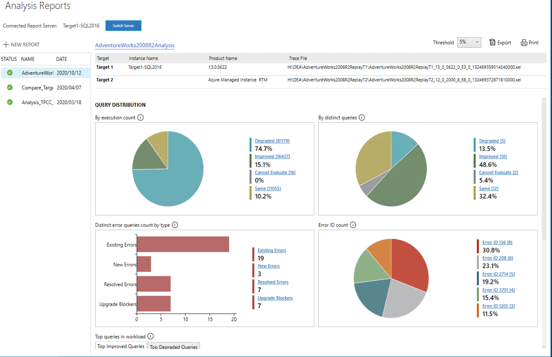
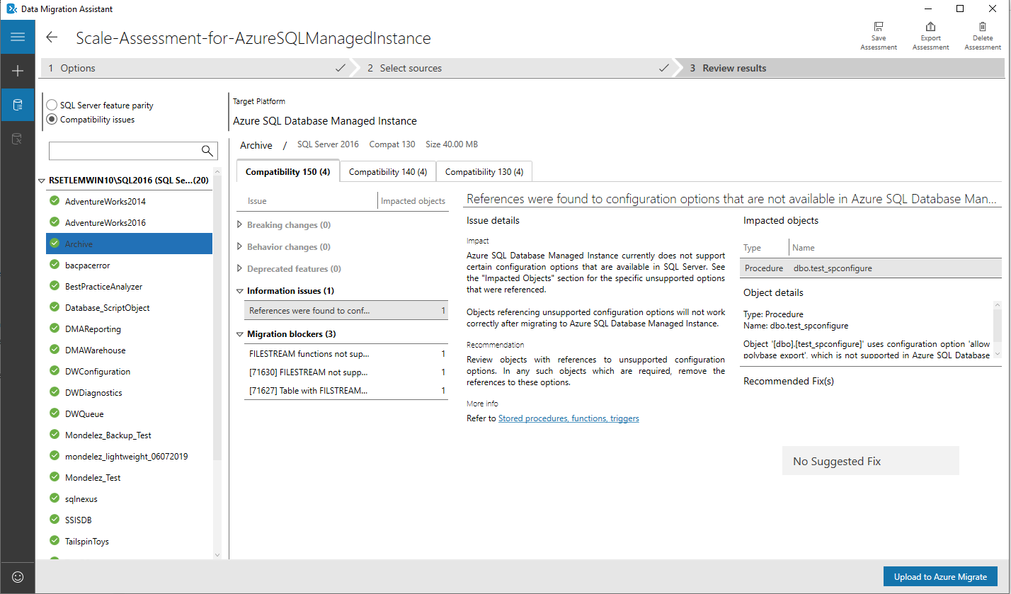
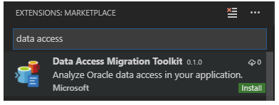
Azure SQL Migration - Current tools and services
Phases in migration journey: Discovery → Assessment → Migration
Discovery & Assessment phase:
Azure Migrate
Central hub to discover and assess workloads.
Assessment & Migration phase:
Data Migration Assistant (DMA)
Used for assessment and migration
Data Access Migration Toolkit (DAMT)
Used for accessing data access layer
Database Experimentation Assistant (DEA)
Used for A/B testing
SQL Server Migration Assistant (SSMA)
Used for migrating from heterogenous source (Oracle, DB2, Sybase, MySQL, Access) to SQL Server
Azure Database Migration Service (DMS)
PaaS service used for migration

Slide 6
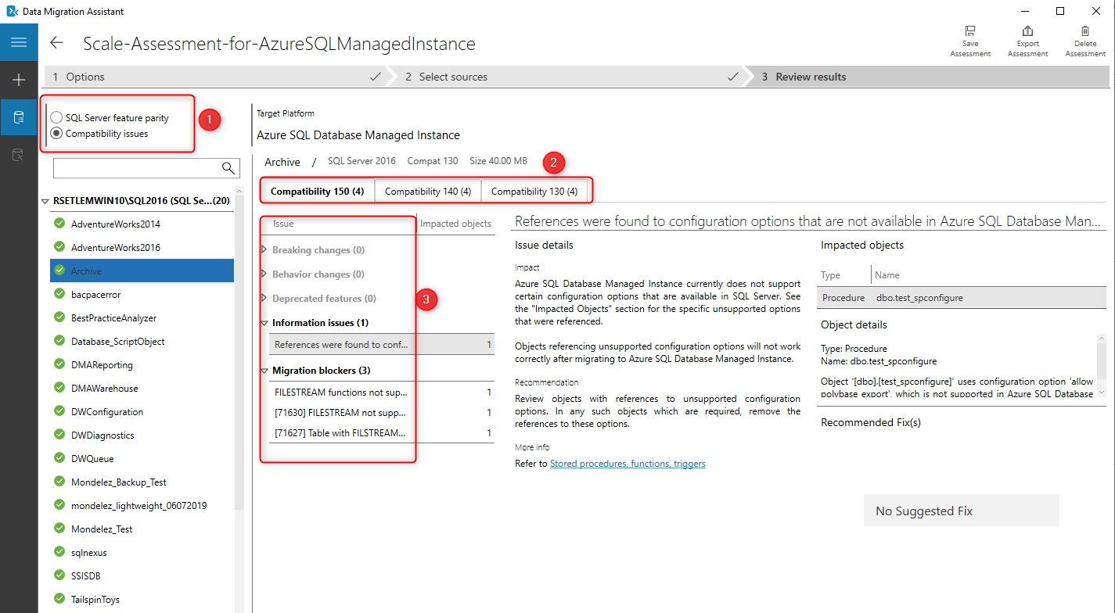
Data Migration Assistant (DMA)
Capabilities:
De facto tool for running assessments for On-premises & Azure SQL target (very popular with customers)
Used both in upgrade and migration scenarios
Offers simplicity and value
Extensively used today for Azure SQL DB migrations
Gaps:
Being a standalone tool, lacks resiliency for migration
Assessment for larger schemas is time consuming
Assessment rules were not public causing staleness
Assessment results created unintended confusion
Feature parity & Compatibility Issues (1)
Compatibility mode analysis (2)
Too many categories for issues identified - Breaking changes, Behavior changes, Deprecated features, Information issues, Migration blockers (3)

Slide 7
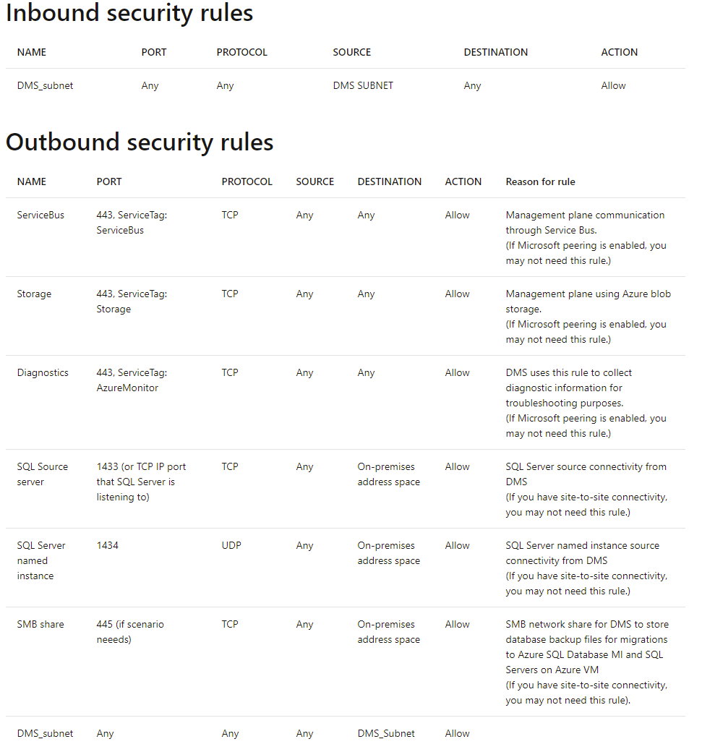
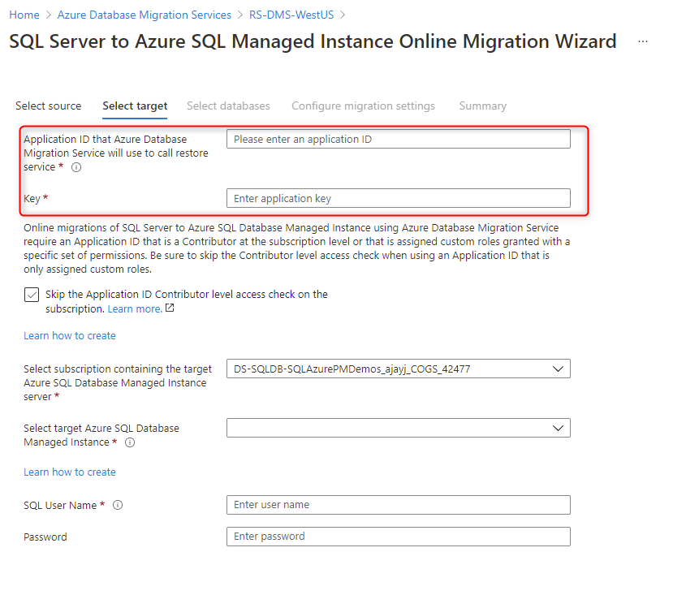
Database Migration Service (DMS)
Capabilities:
Supports migration to both Azure SQL and OSS databases
Managed service and requires injecting into customer’s VNet
UI and rich CLI for automation
Supports minimal downtime migration
Does schema generation and data migration for Azure SQL DB
Gaps:
Requires express route or site to site VPN connectivity
Inbound and Outbound ports should be opened to allow management traffic
Doesn’t support online (minimal downtime) migration to Azure SQL VM
Need for Azure Active Directory (AAD) application ID to perform restores on target Azure SQL
Inability to mitigate stuck or failing migration workflow due to architectural limitations.

Slide 8

What’s new

Slide 9
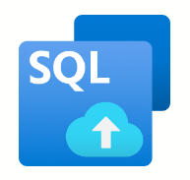
What’s coming in Azure SQL Migrations
Simplified assessment & migration capabilities
Cohesive and connected experience while navigating through migration phases (Discovery → Assessment → Migration)
Complete migration scenarios for Azure SQL (MI, VM & DB)
Improved reliability & scalability

Slide 10
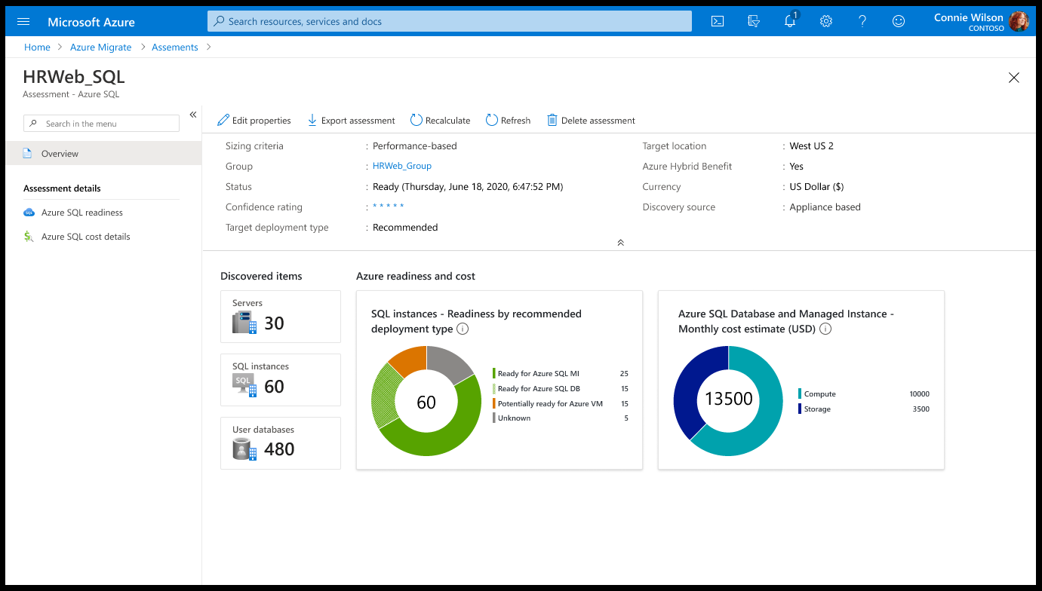
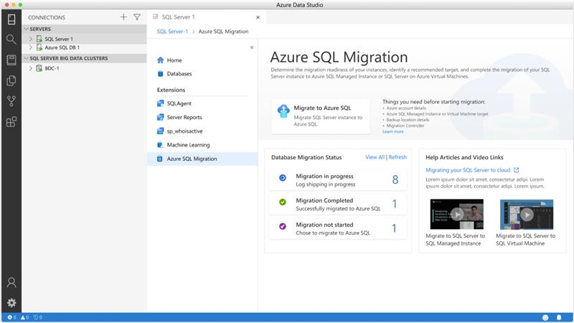
Migration personas (Azure SQL)
A Business decision maker needs …
Business case to migrate / modernize their on-premises data estate
At scale discovery and assessment to analyze configuration, performance, and application dependencies for migrating to Azure SQL
Azure SQL readiness, right sized SKU and cost projections
Make the best Azure SQL migration decisions (IaaS Vs PaaS) with built-in insights and recommendations
A Database/Application owner needs …
One unified tool or service to migrate
Simple and seamless migration experience for handful of SQL Server databases
Easy to set up and get started
Resilient, reliable and minimal downtime migrations.
Azure Migrate Integration (Public preview)
Azure SQL Migration extension in ADS (Private preview)

Slide 11
Tenets for new migration tools / services
Consistency and reusability of the new assessment engine in both Azure Migrate and ADS.
Consistency and reusability of migration technology under DMS in both ADS (for single workloads) and in Azure Migrate (for large scale migrations).
Ease of use and lessen friction to get started for anyone wanting to migrate single line of business application workloads or large-scale data centers.
Simplified, connected and intelligent user experience for the end user.

Slide 12
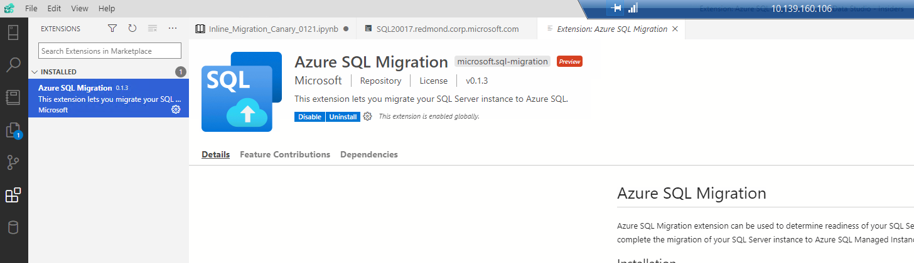
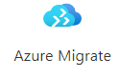



Which SQL Server Migration tool is right for you?
Scenario
Discover
Assess
Target SKU
Migrate
SQL Server estate on Vmware
Migrate to SQL VM/ SQL MI?
Discover and assess your SQL Server data estate with unified Azure Migrate, to get Azure SQL readiness, Azure SQL deployment and optimal tier/SKU recommendations. Migrate to Azure SQL with confidence.
DMS extension in Azure Data Studio (ADS)
SQL Server estate on non-Vmware
Migrate to Azure SQL DB, EP, HS?
Use DMA to assess, upload results to Azure Migrate for Azure SQL readiness summary at scale.
Size<200MB
Deploy schema and migrate data
Use DMA to identify the optimal Azure SQL tier and SKU that can meet your SQL Server workload performance and HA needs on Azure SQL
Size>200MB
Multiple DBs
Migrate Data
Deploy schema
Ad-hoc SQL Server migration
Use DMA to assess, Azure SQL readiness. Perform DMA SKU assessment to identify the optimal Azure SQL tier and SKU that can fit your SQL Server workload on Azure
Full migration automation
PS command-lets DMS
Nominate to DS Ninja for engineering white-glove at https://aka.ms/engage-dpninja
FastTrack helps customers deploy Microsoft cloud solutions.
Azure Migrate & Modernize Program (AMMP)
DMS v1

Slide 13
Migrations using ADS

Slide 14






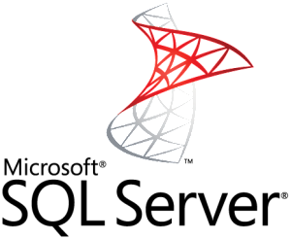






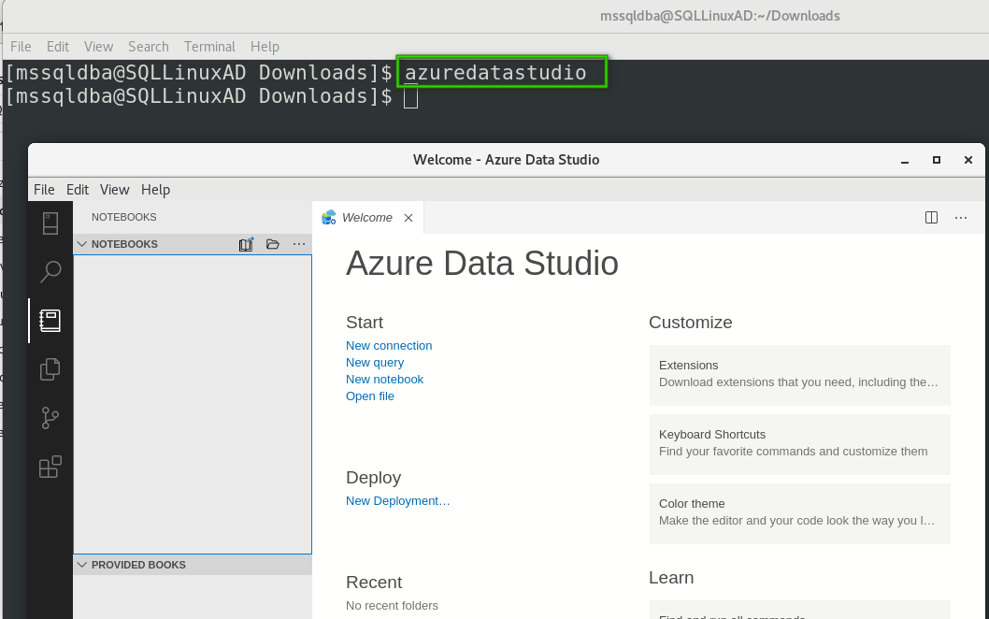
Architecture
Source SQL Server instance in on-premises environment or any cloud (IaaS). 2008 and above, any edition, Windows or Linux.
Azure SQL target Azure SQL Managed Instance or SQL Server on Azure Virtual Machines registered with SQL IaaS Agent extension. 2012 and above, any edition, running on Windows. (Azure SQL DB will be supported soon)
SMB network file share where backup files exist for the database(s) to be migrated. Azure Storage blob Container and file Share is also supported.
ADS Insiders and the extension “Azure SQL Migration”
DMS to orchestrate migration.
DMS is associated with Azure Data Factory’s (ADF) Self Hosted Integration Runtime (SHIR)
DMS leverages SHIR to upload backup files from SMB network share to Azure Storage account (customer owned)
DMS restores backup files on Target Azure SQL
When all files are restored, cut over to complete migration
On-Premises / Compete cloud (IaaS)
Subscription
1
5
Source SQL Server:
Source SQL Server database (2008 and above, any edition, Windows/Linux)
2
DMS service is associated with Self-Hosted Integration Runtime
Get auth keys for registration
Check SHIR online status
3
DMS:
Orchestrates migration activities
SMB File Share:
Source database backup file's location for full and log backups
Target:
Azure SQL MI (or)
SQL Server on Azure VM
6
Self-hosted Integration Runtime
7
4
DMS leverages SHIR to upload backup files to Azure storage after validation
8
9
ADS Insiders and the extension “Azure SQL Migration”
Azure Storage Account:
Blob storage container where backup files will be uploaded
DMS restores backups
Azure resource managed by user

Slide 15
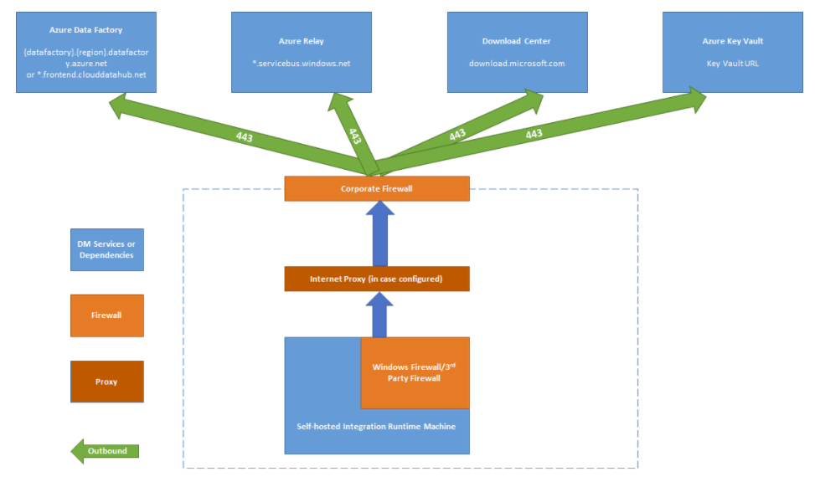
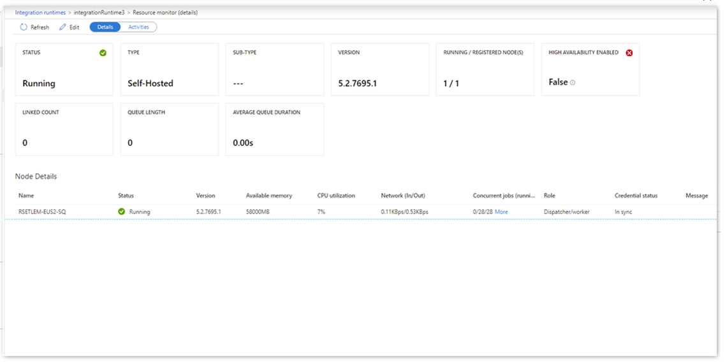
Capabilities of Self Hosted Integration Runtime (SHIR)
Provides compute in Hybrid environment
Simple to install
Provides resilient file copy activity
Runs in on-premises or any IaaS VM network and can access SMB file share.
Requires only outbound port 443 to select domain names.
Works with or without express route/site to site VPN connectivity.
Exposes rich monitoring data
Provides high availability (up to 4 nodes/VMs)
Supports auto update
Credentials are encrypted by DPAPI locally or by Azure Key Vault
Secure, complaint and certified in many enterprises.

Slide 16
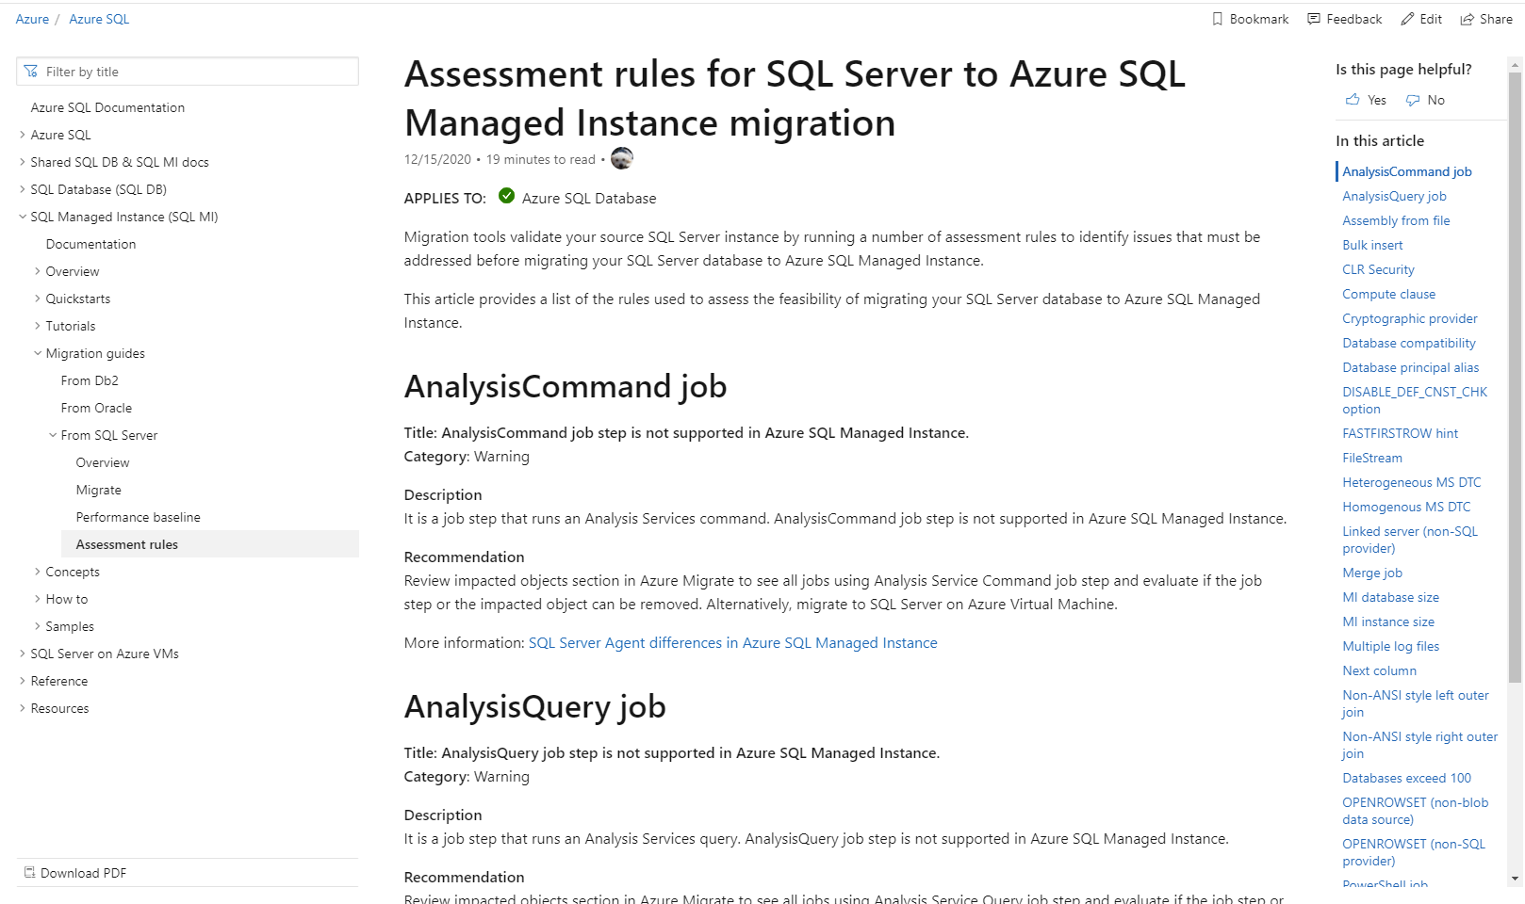
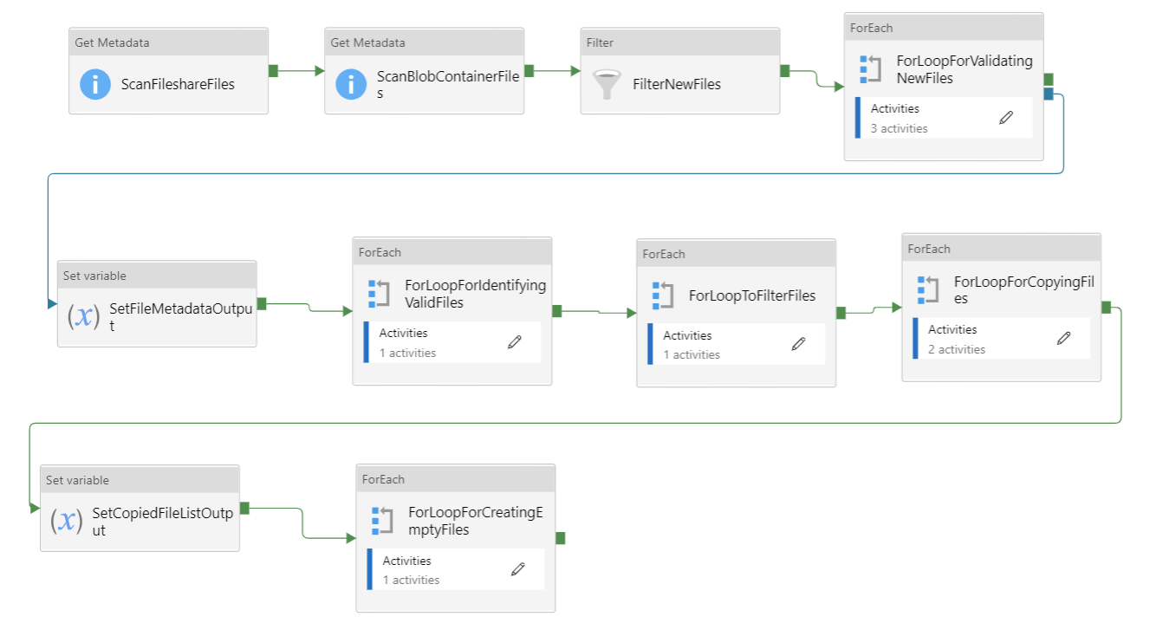
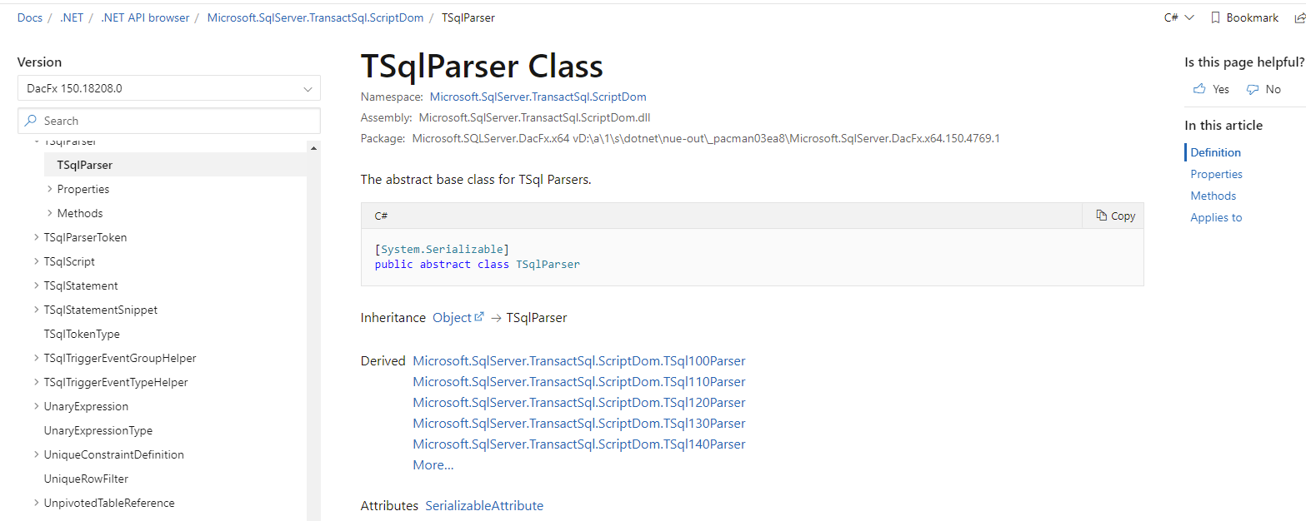
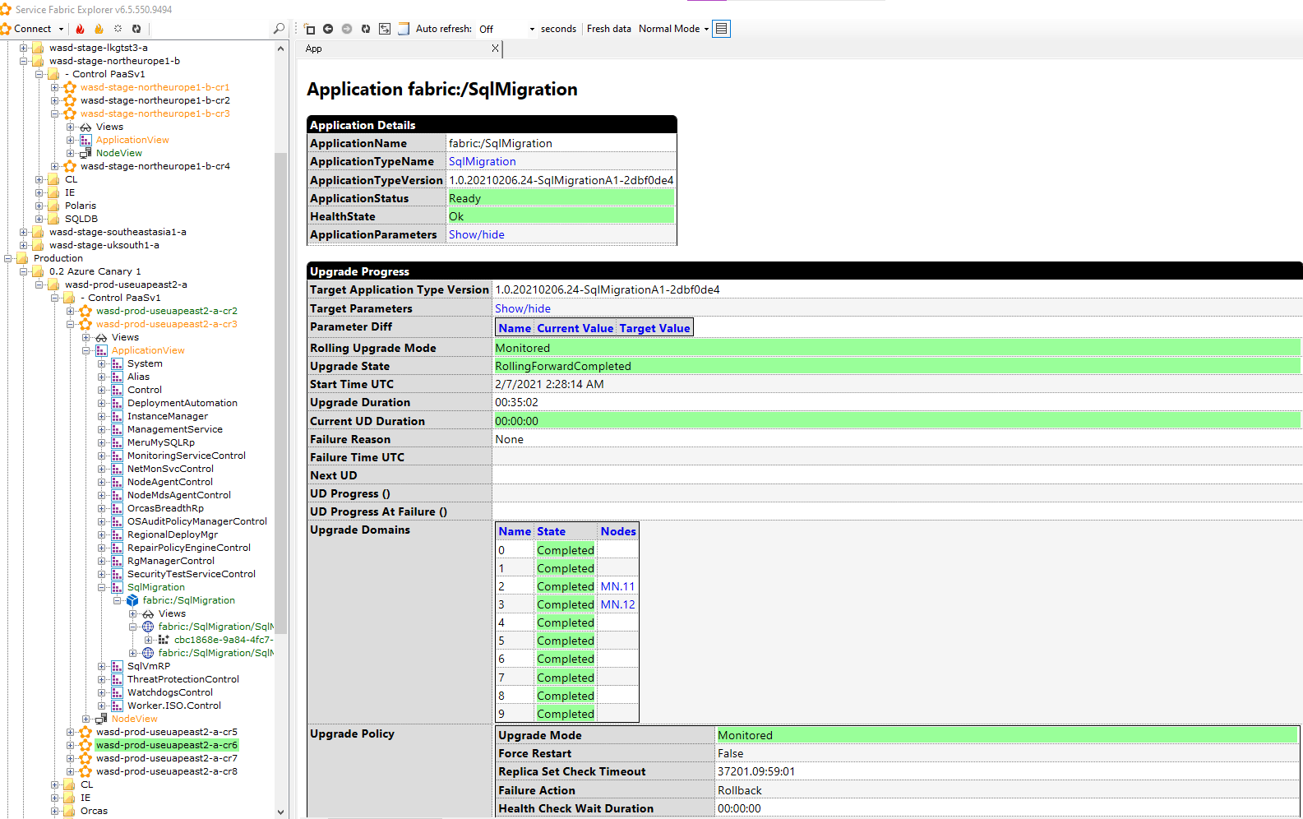
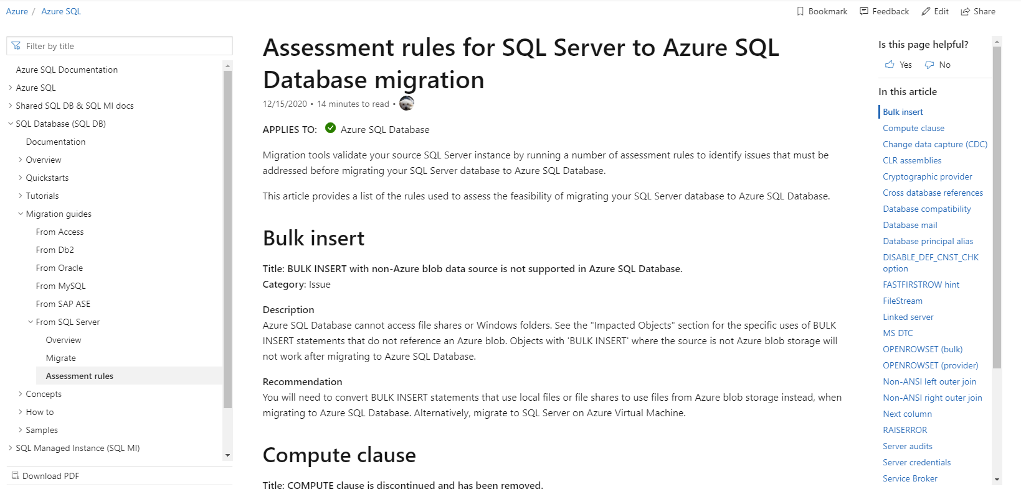
Migrations from ADS- Enhanced capabilities
Integrated assessment and migration experience. (SKU recommendation in future)
Assessment rules (MI & DB) are published in docs
Assessment engine is based on robust and scalable TSQL script DOM parser
Minimal downtime migrations to both Azure SQL Managed Instance and SQL Server on Azure Virtual Machines
DMS control plane is on the platform (service fabric stateless service) as is Azure SQL – Leverages built in features (Scalability, HADR, Auto healing, Deployment, Security, Telemetry etc)
DMS leverages well know and popular ADF pipeline to host business logic for determining relevant backup files to upload.

Slide 17
ADF Pipeline

Slide 18
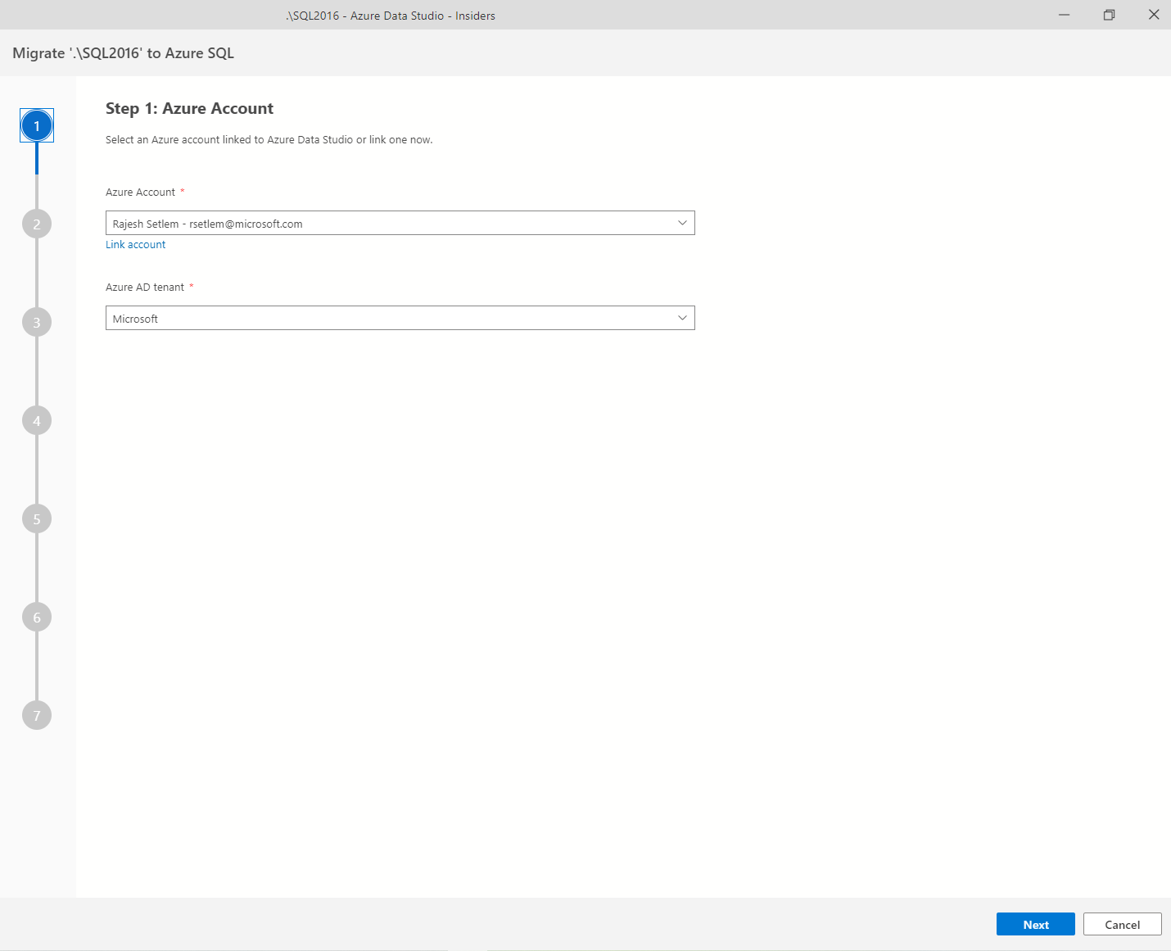
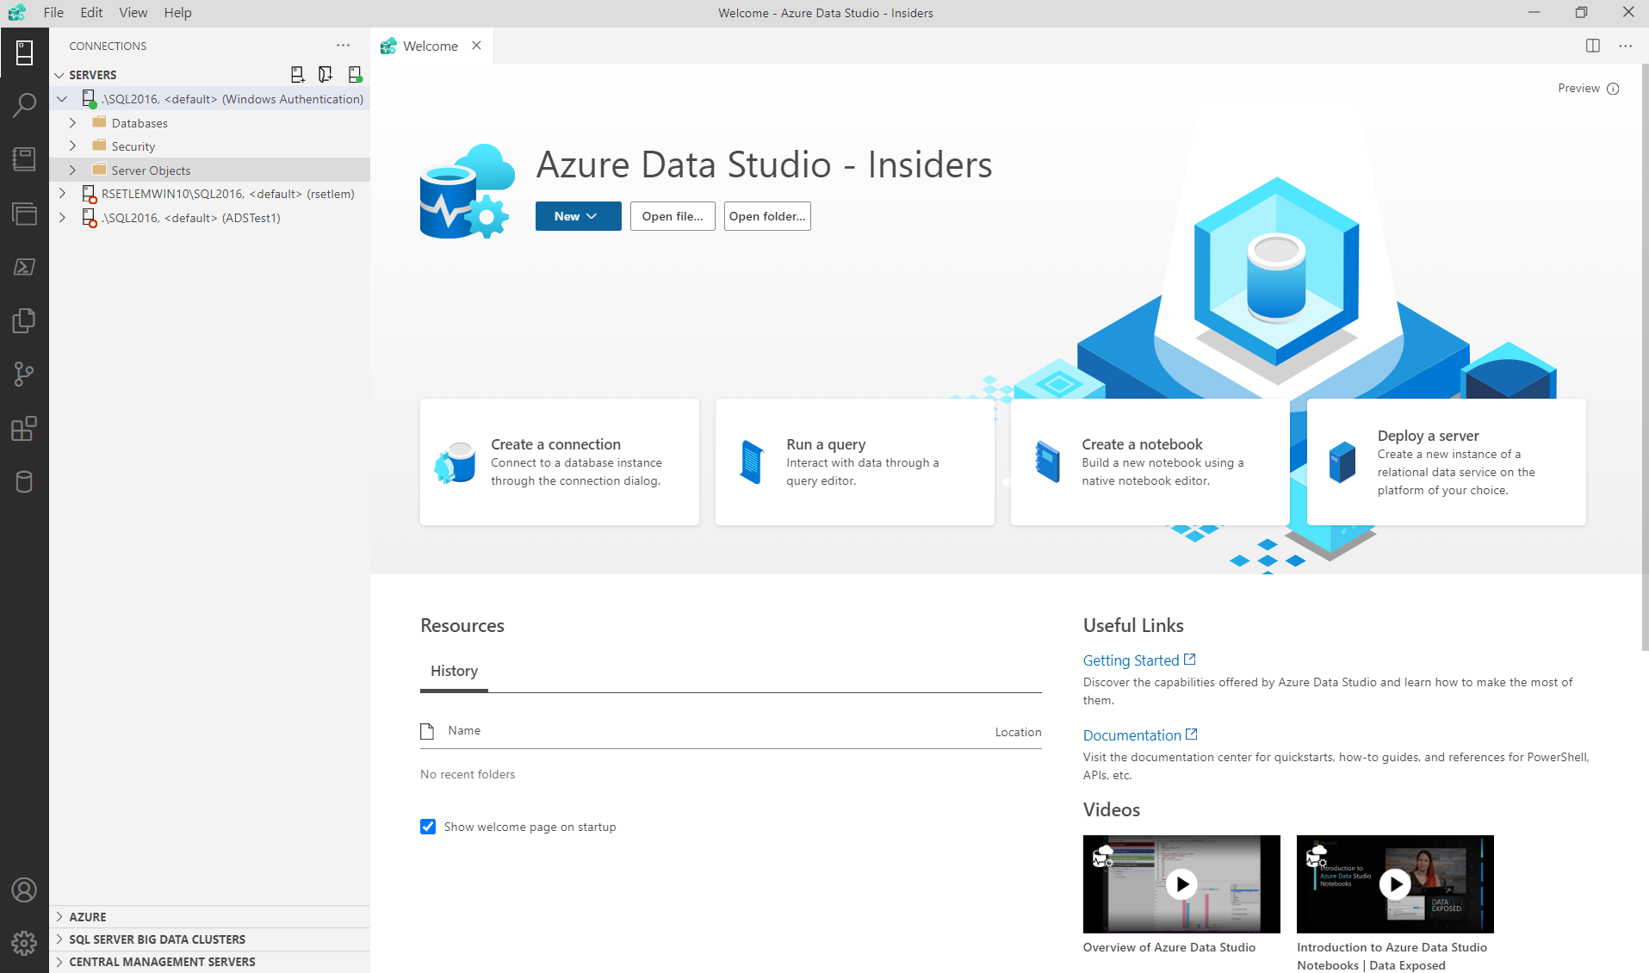
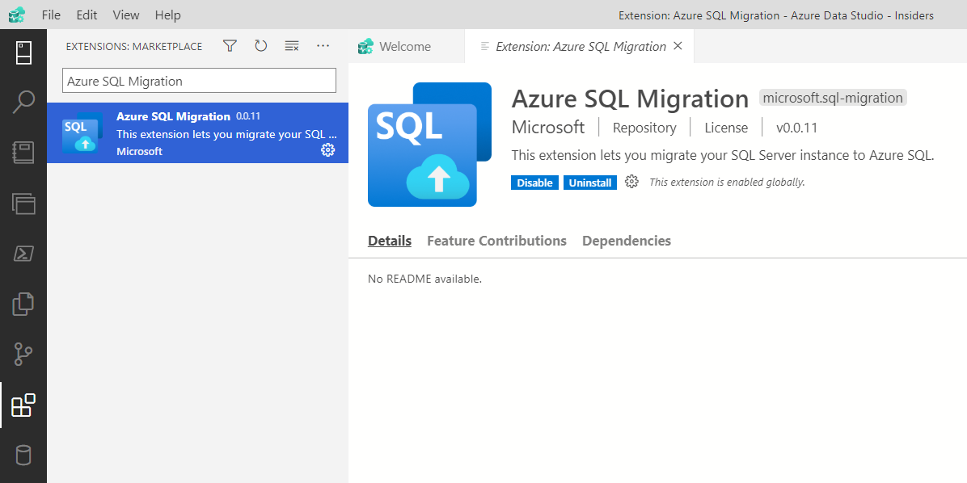
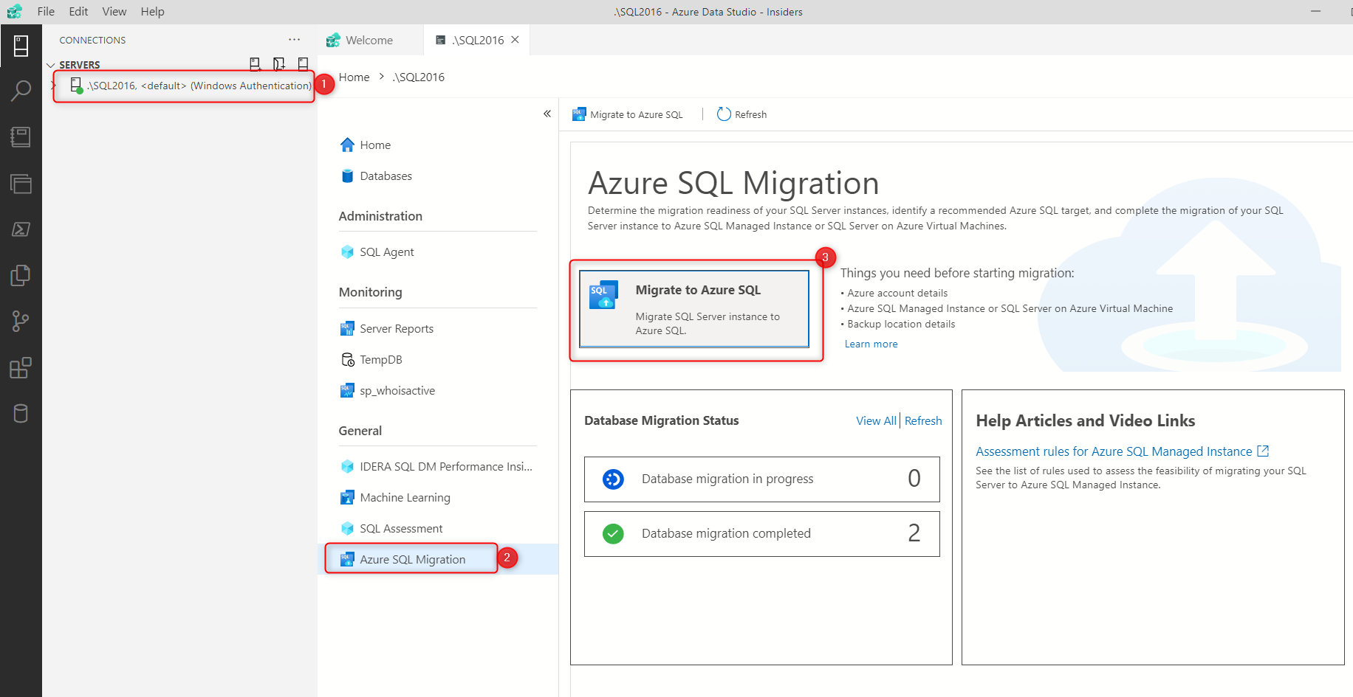
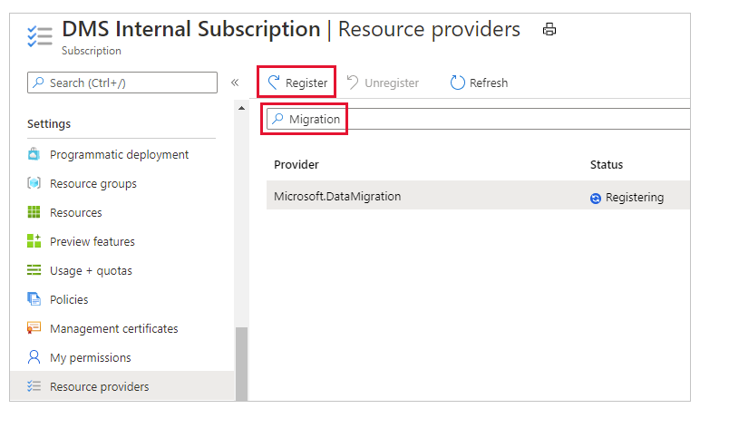
Azure SQL Migration from ADS – Getting started in private preview (https://aka.ms/ads-sql-migration)
Install latest version of Azure Data Studio Insiders (This can be installed side by side with stable release of Azure Data Studio)
Install “Azure SQL Migration” extension from extension marketplace.
Provision an Azure SQL target (SQL VM or SQL Managed Instance) in EAST US2 region if one does not exist already.
Register Microsoft.DataMigration resource provider if it is not yet registered in the subscription.
Launch wizard experience in “Azure SQL Migration” extension to migrate database.
Step # | Page Name | Description
Step 1 | Azure Account | Use an Azure account that’s already linked or link a new one.
Step 2 | Assessment results Azure SQL Target | Azure SQL readiness assessment runs in the background to help you identify the right Azure SQL target.
Step 3 | Migration Mode | Select between Online or Offline migration mode
Step 4 | Database Backup | Select location of backup files On-premises: Provide the network share location where backups exists and user credentials that has read access to the share Provide Azure Storage Account where backup files have to be copied to.
Step 5 | Azure Database Migration Service (DMS) | Create DMS Download Self Hosted Integration Runtime (SHIR) Install SHIR Register SHIR with one of the authentication keys displayed while DMS was created Check connection status to ensure DMS is connected to SHIR
Step 6 | Summary | Review summary and start migration.
Public Preview – Q1 FY22

Slide 19
Demo

Slide 20
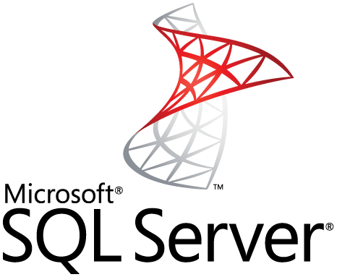


Customer Scenarios
Business Situation
Source - Target
Customer has 100s of databases on their on-premises SQL Server that they want to migrate to Azure SQL MI.
They are looking for an option to migrate all the databases at once without much manual effort.
DS Ninja team analyzed their current environment and recommended them to use migration extension in Azure Data Studio-Insider for migrating their databases
Customer felt comfortable moving all their databases to SQL MI because of the simplified migration process
This migration will increase their presence on Azure and eventually they are planning to migrate their applications to Azure as well.
Business Impact
Solution
Business Situation
Source - Target
Customer was exploring all possible solutions to easily migrate one of their business applications from AWS EC2 to Azure SQL MI.
Given the criticality of their business, they needed a solution to migrate with the lowest downtime
Customer signed up for the migration extension in Azure Data Studio in Private Preview to try the experience.
They were happy with the experience and decided to migrate their Production database
“Azure SQL migration is very helpful for our project. ‘Online migration’ can keep the source database working during the migration process, and it only takes less than 5 minutes to switch from the source database to the target database. The shortest downtime is essential for database migration in a production environment.”
Customer Feedback
Solution

